Slide 1
NER with custom dataset
Priyank Soni

Slide 2
Baseline model
Using spaCy’s pretrained model `en_core_web_sm` an English language multi-task Convolutional Neural Network(CNN) trained on OntoNotes.
Detecting entities with this model:
text = "Thousands of demonstrators have marched through London to protest the war in Iraq and demand the withdrawal of British troops from that country."
Thousands CARDINAL of demonstrators have marched through London GPE to protest the war in Iraq GPE and demand the withdrawal of British NORP troops from that country.

Slide 3
Custom train spaCy ner pipeline
To train a spaCy NER pipeline, we need to follow 5 steps:
Training Data Preparation, examples and their labels
Conversion of data to .spacy format
Creating the config file for training the model
Filling the config file with required parameters
Run the Training

Slide 4
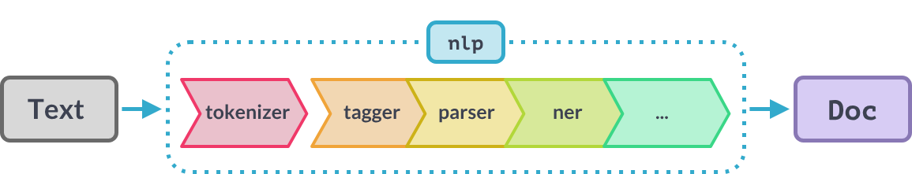
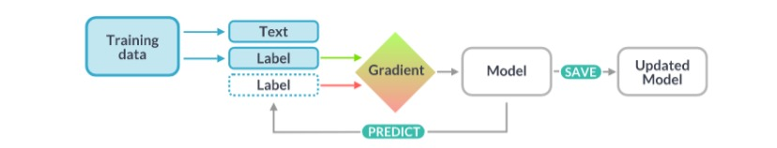
Figure1: Text get converted to a doc object
Figure 2: spaCy model training process

Slide 5
Some training examples
Sentence: Thousands of demonstrators have marched through London to protest the war in Iraq and demand the withdrawal of British troops from that country .
Entities: {'entities': [(48, 54, 'B-geo'), (77, 81, 'B-geo'), (111, 118, 'B-gpe')]}
Sentence: Families of soldiers killed in the conflict joined the protesters who carried banners with such slogans as " Bush Number One Terrorist " and " Stop the Bombings . "
Entities: {'entities': [(109, 113, 'B-per')]}
Sentence: They marched from the Houses of Parliament to a rally in Hyde Park .
Entities: {'entities': [(57, 61, 'B-geo'), (62, 66, 'I-geo')]}

Slide 6
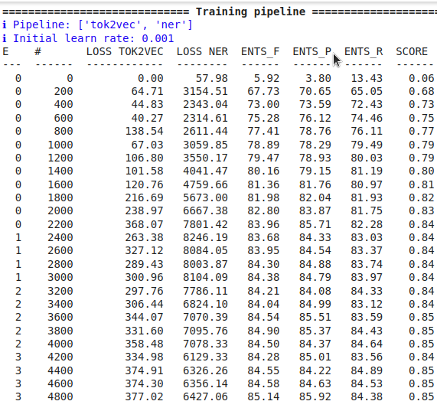
Training logs of the spaCy model

Slide 7
Prediction on the trained model
Text = Friday prayers brought calls from Sunni Arab clerics for followers to reject federalism and vote against a constitution containing provisions that divide the country.
Friday B-tim prayers brought calls from Sunni B-geo Arab B-gpe clerics for followers to reject federalism and vote against a constitution containing provisions that divide the country.
Ideally Sunni Arab should have been recognised as one entity (Sunni B-geo, Arab I-geo)
Text = City officials took the measure after gangs set fire to at least six buses Thursday, burning seven people alive.
City B-geo officials took the measure after gangs set fire to at least six buses Thursday B-tim , burning seven people alive.

Slide 8

Observations
Initial Stage (Epoch 0, Step 0)
At the start, the model performs poorly with a low F1-score (ENTS_F = 5.92).
Loss values are relatively high, indicating the model is just starting to learn.
Mid-Training (Epoch 0, Step 2000)
F1-score improves to 82.80, showing significant learning progress.
Loss for tok2vec and ner has increased temporarily due to model adjustments (e.g., learning new patterns).

Slide 9
Observations…
Later Training (Epoch 3, Step 4800)
Final F1-score is 85.14, with good precision (85.92) and recall (84.38).
Loss values stabilize, suggesting the model has converged.

Slide 10
Fine-tuning BERT for named-entity recognition
We are going to use BertForTokenClassification which is included in the Transformers library by HuggingFace. This model has BERT as its base architecture, with a token classification head on top, allowing it to make predictions at the token level. We will be using 'bert-base-uncased' model
To finetune NER model, we need to follow 5 steps:
Training Data Preprocessing, examples and their labels
Preparing the dataset and dataloader
Defining the model
Training the model
Evaluating the model

Slide 11
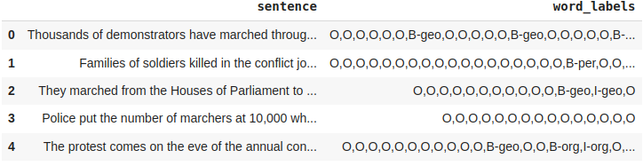
Data preparation
Count of entities:
[('geo', 45058), ('org', 36927), ('per', 34241), ('tim', 26861), ('gpe', 16068), ('art', 699), ('eve', 561), ('nat', 252)]

Slide 12
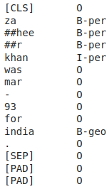
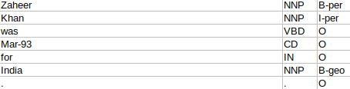
Sentence: Zaheer Khan was Mar-93 for India .
Figure:How this example looks in dataset
Figure: first 15 tokens and corresponding labels

Slide 13
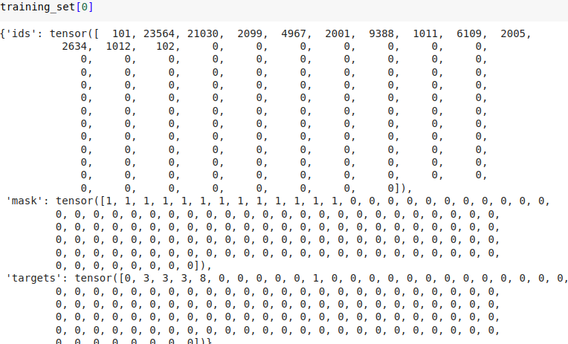

Slide 14
Evaluation
Validation loss per 100 evaluation steps: 0.03998514264822006
Validation loss per 100 evaluation steps: 0.030500035890606278
Validation loss per 100 evaluation steps: 0.026118076212610933
Validation loss per 100 evaluation steps: 0.026614292803223544
.
.
.
.
Validation loss per 100 evaluation steps: 0.026070216573945863
Validation loss per 100 evaluation steps: 0.025895537645989175
Validation loss per 100 evaluation steps: 0.02573938687368907
Validation Loss: 0.025820782228428707
Validation Accuracy: 0.962177378078725

Slide 15
Evaluation….
precision recall f1-score support
geo 0.81 0.89 0.85 11232
gpe 0.95 0.91 0.93 3293
org 0.69 0.62 0.65 6531
per 0.77 0.79 0.78 5196
tim 0.84 0.82 0.83 4360
micro avg 0.80 0.81 0.80 30612
macro avg 0.81 0.81 0.81 30612
weighted avg 0.80 0.81 0.80 30612

Slide 16
Inference
sentence = "India has a capital called Mumbai. On wednesday, the president will give a presentation"
india has a capital called mumbai . on wednesday , the president will give a presentation
['B-geo', 'O', 'O', 'O', 'O', 'B-geo', 'O', 'O', 'B-tim', 'O', 'O', 'O', 'O', 'O', 'O', 'O']

Slide 17
Deployment
you can save everything locally, simply by calling model.save_pretrained() and tokenizer.save_pretrained(), providing a directory path as argument.
you can push the files to the HuggingFace hub. This way, you can share your model with the community/your colleagues. All files will be tracked by git, as each model on the hub has its own git repo.

Slide 18
Loading model for inference
from transformers import AutoTokenizer, AutoModelForTokenClassification
model_name = "priyank/bert-finetuned-ner-priyank"
tokenizer = AutoTokenizer.from_pretrained(model_name)
model = AutoModelForTokenClassification.from_pretrained(model_name)
pipe = pipeline(task="token-classification", model=model.to("cpu"), tokenizer=tokenizer, aggregation_strategy="simple")
pipe("My name is Niels and New York is a city")
[{'entity_group': 'per', 'score': 0.43604735, 'word': 'ni', 'start': 11, 'end': 13},
{'entity_group': 'per', 'score': 0.5974575, 'word': '##els', 'start': 13, 'end': 16},
{'entity_group': 'geo', 'score': 0.9449212, 'word': 'new york', 'start': 21, 'end': 29}]

